Slide 1
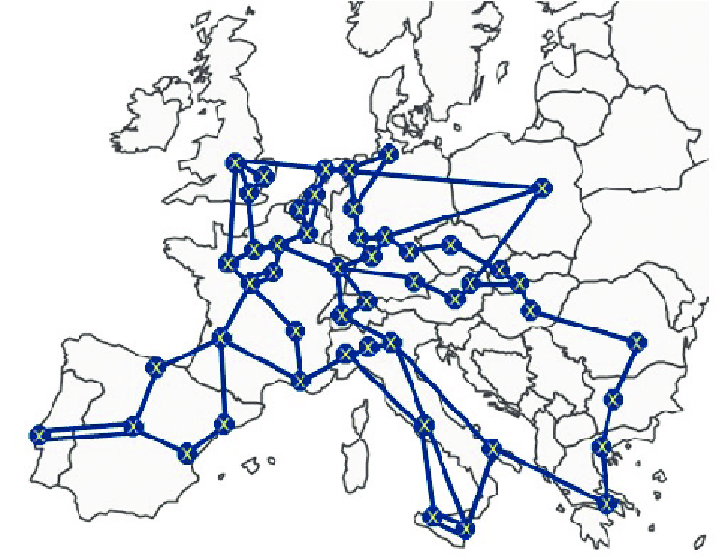
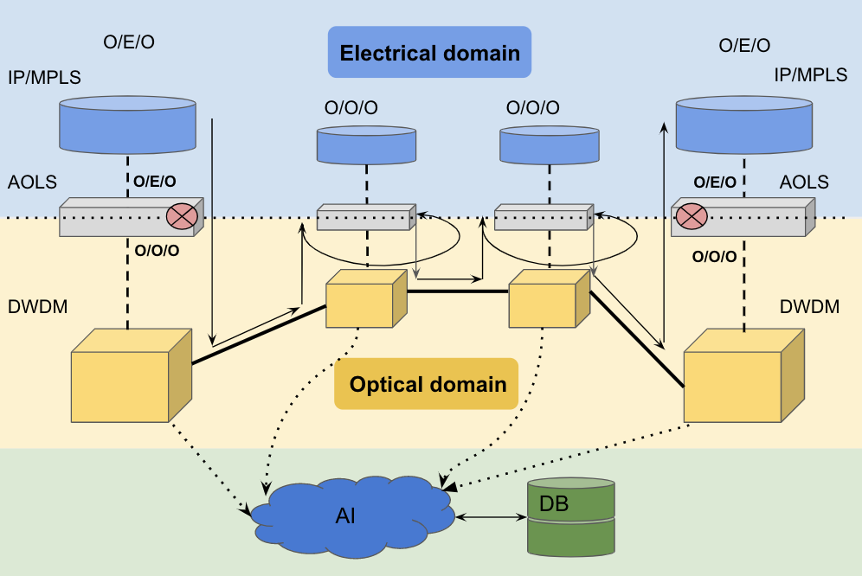
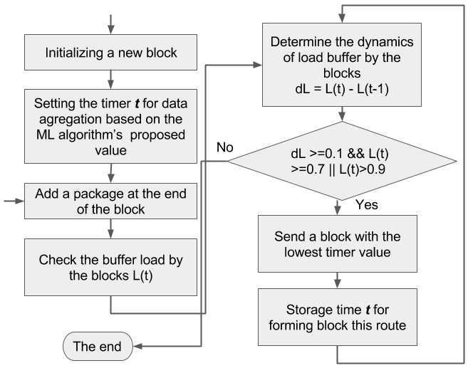
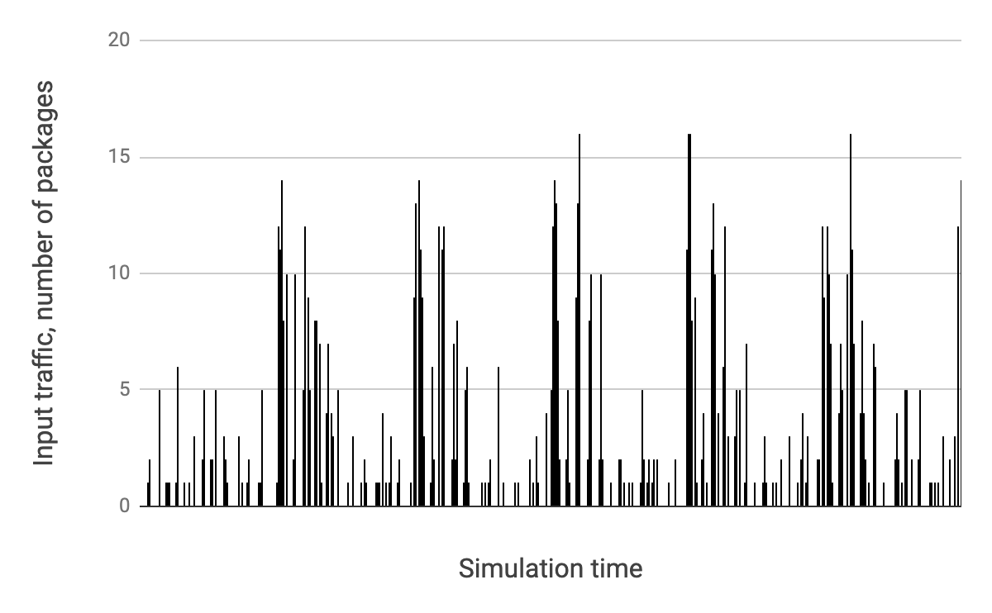
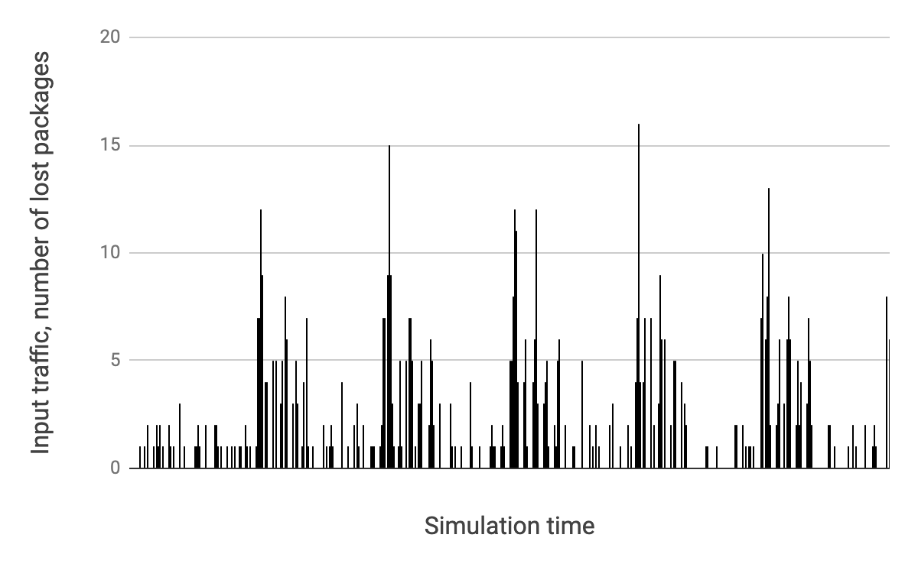
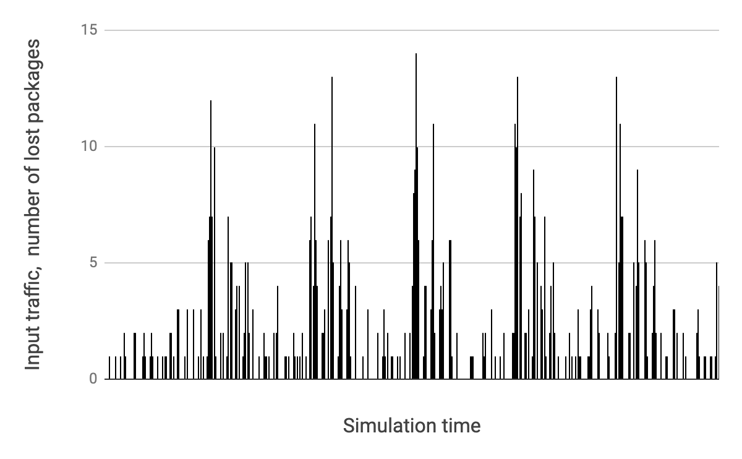
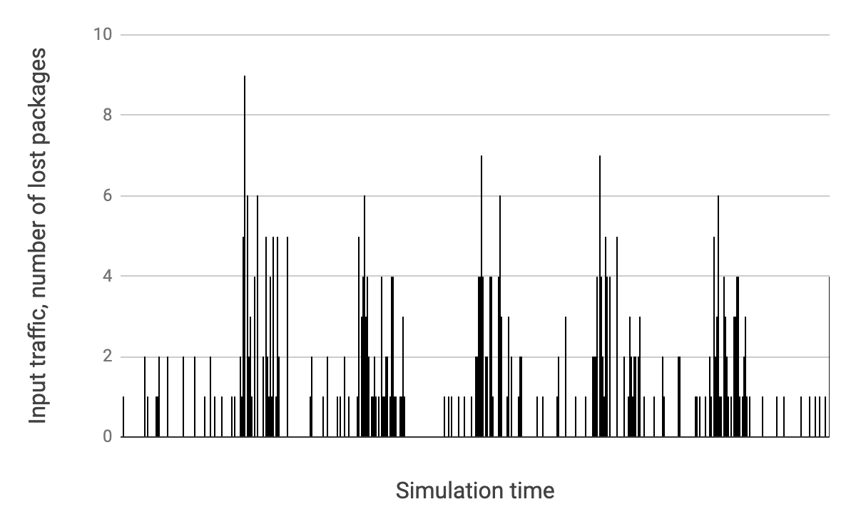
2020 IEEE 15th International Conference on Advanced Trends in Radioelectronics, Telecommunications and Computer Engineering (TCSET-2020)
Smart Payload Management in Edge Nodes of Optical Label Switching Networks
Authors: V. Andrushchak, T. Maksymyuk, M. Kaidan, M. Klymash
Introduction
Any telecommunications operator is trying to reduce cost in telecommunication networks. However, it tries to provide the necessary quality of service for end-users. In addition, the ITU-T provides own requirements for optical transport networks. There are a number of technical things which influence cost: the efficiency of use of network resources (spectral, time, energy), deployment and adaptation times, support of new services. Telecommunication traffic has changed significantly over the last 10 years. Traffic from the Internet of Things (IoT), cloud services, streaming video is very diverse. Size of IP packages for networks of the Internet of Things (IoT) is small (80-100 bytes). This number of packages can increase the amount of service data in channels. Streaming video is sensitive to delay according to the QoS (Quality of Service). Each type of traffic has its own peculiarities and requirements for its transmission over the network. There are a number of technologies, algorithms, equipment, which allows resolving certain problems of the operator. Therefore, algorithms that allow you to properly aggregate and break up telecommunication traffic allow you to constantly improve the efficiency of using network resources. However, static algorithms are not sufficient to reduce problems and therefore we suggest finding new ways to solve problems. One of these tools is to use neural networks to resolve these problems.
Requirements to the Optical transport network
Data collection for Neural networks
We suggest to use optical label switching (OLS) technology for processing service data and payload in the optical domain at the intermediate nodes (see fig. 1).
Fig. 2. Core optical transport network in Europe
Fig. 1. Researched network (O/E/O - electrical domain, O/O/O - optical domain, IP/MPLS - equipment of network level, AOLS - equipment of link level, DWDM - equipment of DWDM level, AI - artificial intelligence, DB - database).
Fig. 3. The part of the algorithm for static traffic aggregation based on AI for edge nodes
Our suggested architecture of telecommunication network has next requirements: all traffic should bypass extra IP/MPLS routers on the intermediate nodes, payload should be operated without opto-electronic conversion on the intermediate nodes, OLS equipment aggregate IP packages in OLS transport units on the edge node of an optical transport network. Also, these equipment create LSP (link level) for every transport block or group of these blocks, OLS switchers use optical labels as wavelength for processing payload.
Simulation of the smart aggregation algorithm
Table 1. Parameters of the AI model
Table 2. Number of lost packages
Input parameters for AI model are presented in table 1. This model is a fully connected network with structure 100x100. Simulation is done for different types of traffic (voice, video, data) and different times of the day (morning, lunch, evening, night) Distribution laws were obtained based on real traffic. The simulation results are presented in Figure 4. and Table 2.
According to the simulation results, our smart aggregation algorithm can reduce amount of service data with using artificial intelligence tools. The simulation results demonstrate that the proposed ML-based traffic aggregation algorithm is capable for predicting the size of the OLS data block with allowable losses, even when the law of distribution of incoming traffic is changing..
Parameter | Value | Parameter | Value
Iteration | 20000 | Learning rate | 0.0001
Hidden layer | 100 | activation function | relu and tanh
Hidden neurons | 100
Part of day | lost packages, %
morning | 8,09
noon | 3,01
evening | 2,96
night | 1,65
morning
noon
Fig.4. Distribution of lost packages
evening
night
Conclusions
In this paper, the architecture of optical transport network based on OLS technology is suggested. This technology avoids an opto-electronic conversion on the intermediate nodes of LSP. An algorithm based on AI methods is proposed for adjusting the time of block formation during aggregation of traffic at the network edge nodes. In addition, the AI algorithms can be used to reduce the energy consumption of the transport network based on the derived mathematical model.

